Slide 1
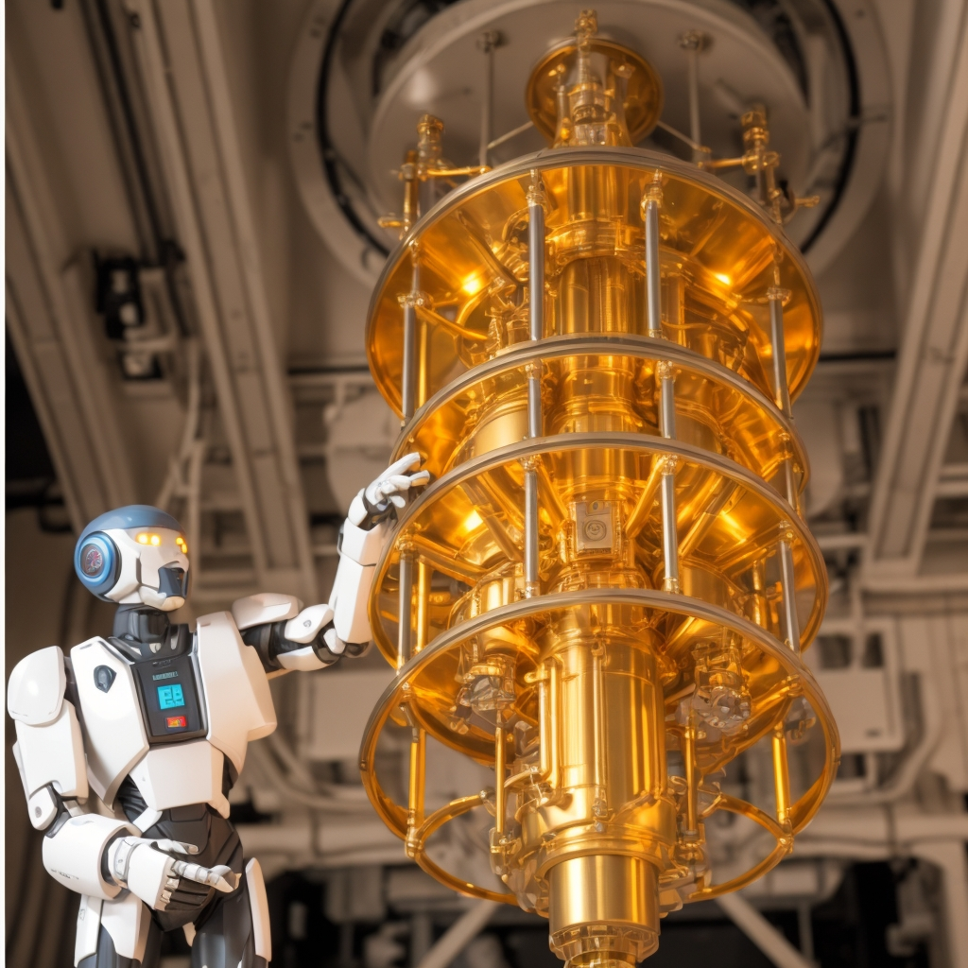
Quantum Wealth AI for Hyper-Personalized Finance
A Quantum-Inspired, Hybrid AI-Quantum Approach to Portfolio Optimization.
Presented by: Sermad Mehdi
M. Naqi Raza M. Mehdi Raza
Rehmat Ali

Slide 2

Abstract & Overview
Traditional investment strategies face challenges with dynamic markets and limited personalization.
Our Quantum-AI Hybrid Model integrates:
Quantum-inspired portfolio optimization (QUBO problem solved via simulated annealing).
AI-driven sentiment analysis for market insights.
Dynamically allocates funds based on individual risk–return profiles.
Streamlit-based Python implementation enables rapid, scalable, and dynamic portfolio optimization.

Slide 3

Business Strategy Overview
BAVE Wealth Management ($50B AUM) aims to deliver hyper-personalized investment strategies. This is achieved by leveraging quantum-inspired techniques and advanced AI.
1
Enhance Returns
2
Improve Scalability
Improve risk-adjusted returns.
Improve scalability in asset allocation.
3
Reduce Complexity
Reduce computational complexity.

Slide 4

Problem Statement
Traditional strategies have inflexible models and time-intensive optimization. They lack personalization and real-time market shift incorporation.
Inflexible Models
Time-Intensive
Lack of Personalization
Traditional models are inflexible.
Optimization is time-intensive.
No individual risk profiles.

Slide 5




Solution Overview
The Quantum-AI Hybrid Model uses quantum-inspired annealing and superposition simulation. It integrates AI sentiment analysis for real-time adjustments.
Annealing
Portfolio selection as QUBO.
Superposition
Evaluates market scenarios.
AI Engine
Integrates sentiment analysis.

Slide 6
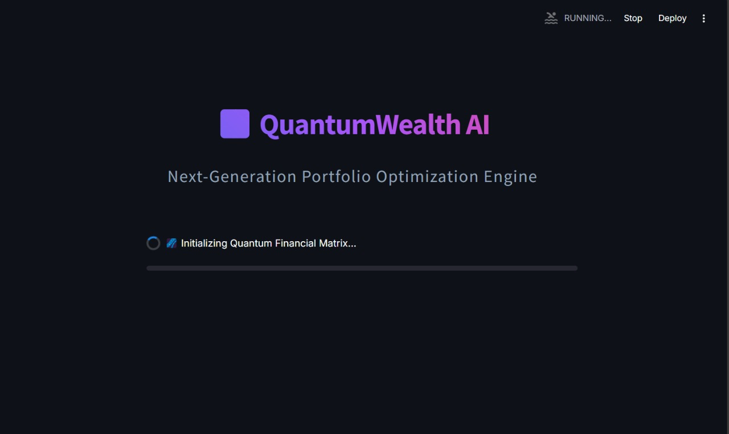



Quantum-AI Enhancements
Quantum-inspired annealing reduces computation time. Superposition simulation enhances risk management. The AI engine dynamically adjusts expected returns.
Faster Computation
Risk Management
Dynamic Allocation
Reduces computation time.
Enhances risk management.
Adjusts expected returns.

Slide 7

Quantum-AI Hybrid
Investment Strategy
Quantum-Inspired Annealing
Portfolio optimization is modeled as a QUBO problem. Solved via simulated annealing (a classical proxy for quantum annealing).
Quantum Superposition
Simulation Simultaneous modeling of multiple market risk scenarios.
Hybrid AI-Quantum Engine
Real-time market sentiment analysis combines:
Pre-classified sentiment data Transformer-based analysis (e.g., Hugging Face models)Hybrid sentiment score adjusts expected returns.
Dynamic Fund Allocation
Investments are allocated based on risk–return ratios, prioritizing low-risk, high-return assets

Slide 8
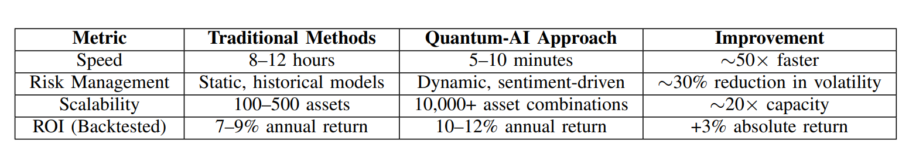
Comparative Analysis
Quantum-AI significantly improves speed, risk management, and scalability. ROI improvement is also notable.

Slide 9
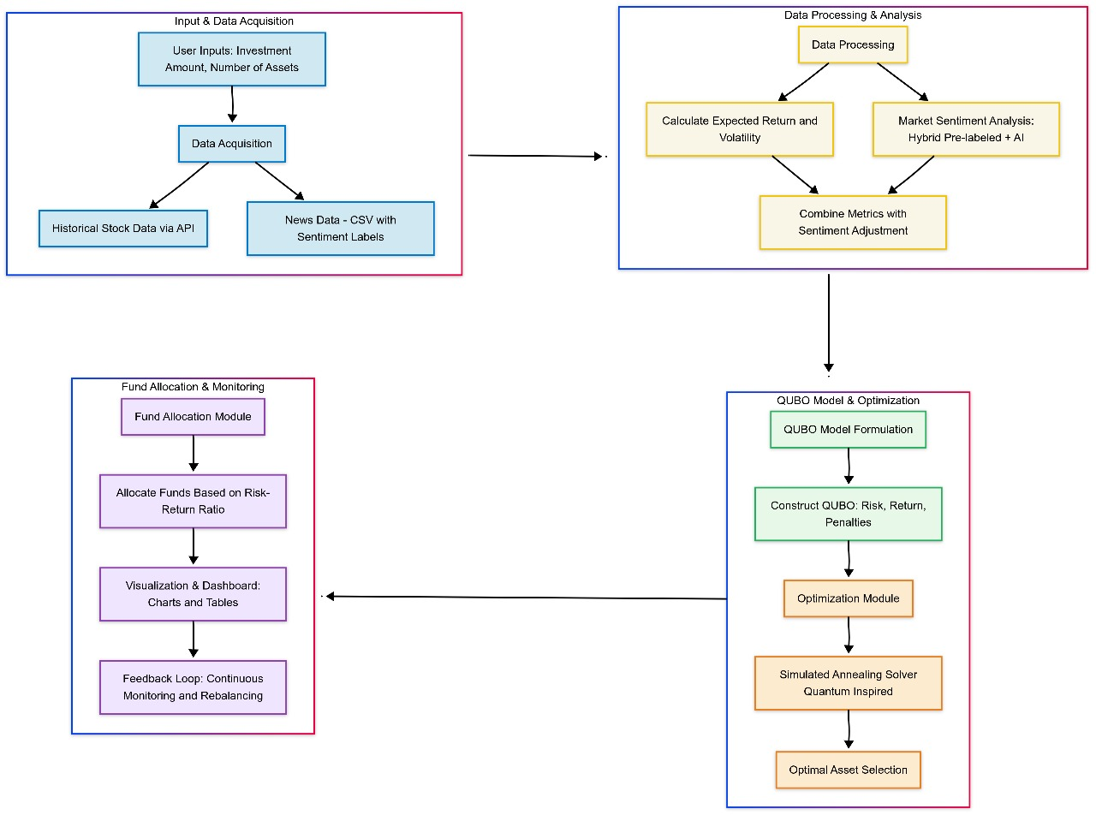
Implementation Roadmap
Phase 1 involves integrating quantum annealing and developing an AI risk sentiment engine. Phase 2 transitions to quantum hardware and expands asset classes.
1
Phase 1
Integrate quantum annealing.
2
Phase 2
Transition to quantum hardware.

Slide 10
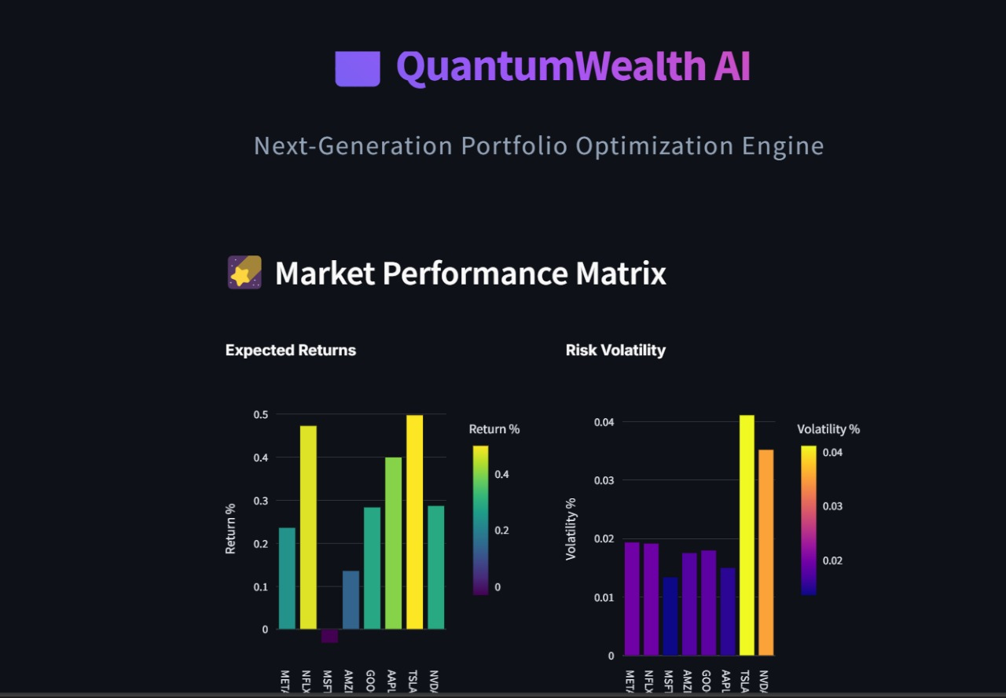
ROI & Business Impact
Projected benefits include loss reduction, client acquisition, and operational savings. BAVE will be positioned as an industry pioneer.
$150M
20%
Loss Reduction
Client Acquisition
Annual savings during downturns.
Increased attraction of high-net-worth individuals.
$8M
Operational Savings
Reduction of rebalancing costs per year.

Slide 11

Conclusion & Acknowledgments
The Quantum-AI Hybrid Model transforms portfolio optimization. It offers significant improvements in speed, risk management, and ROI.
Thanks to BAVE Wealth Management and GIKI Google Developers on Campus.

